Slide 1
ABOUT IMRP
Where the business and science of irradiation connect
The International Meeting on Radiation Processing (IMRP) is recognised as the leading international event for those involved in the applications, science and technology of radiation processing. It is where the business and science of irradiation come together to discuss recent advances, current trends as well as the issues and opportunities that impact the commercial use of ionizing radiation. The IMRP program is always topical and includes regional, technology and application updates from industry leaders.
History
First IMRP was Puerto Rico in 1976
Costa Rica will be the 21st IMRP
Quick Facts
>350 attendees
>120 Submitted abstracts

Slide 2
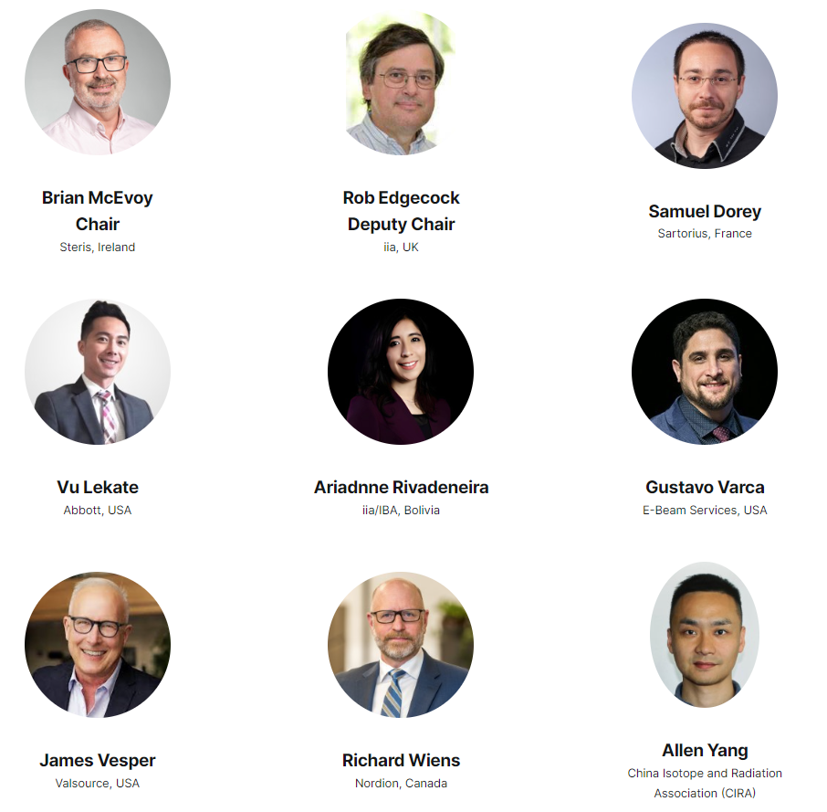
IMRP2024 Program Committee
Industry diverse
SME diverse
Location diverse

Slide 3
Costa Rica
Welcoming. Safe. Spectacular biodiversity. Sustainable.

Slide 4
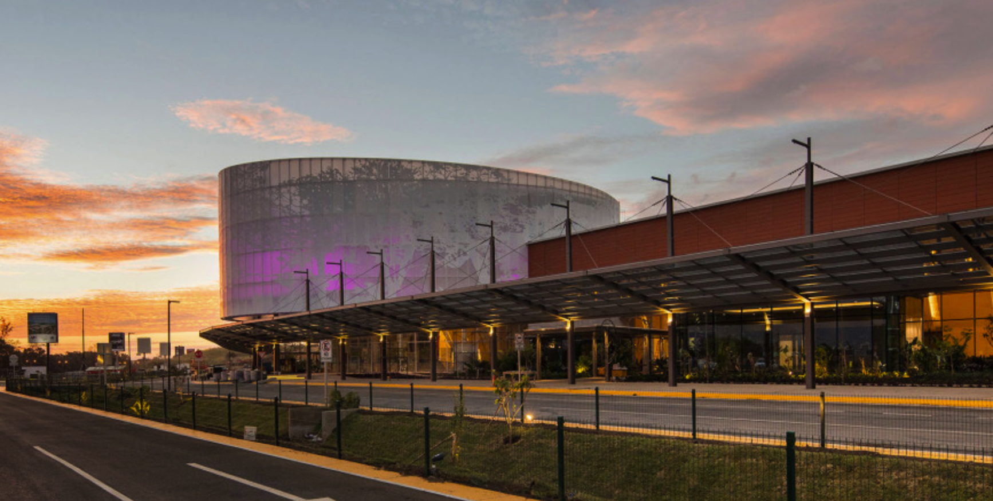
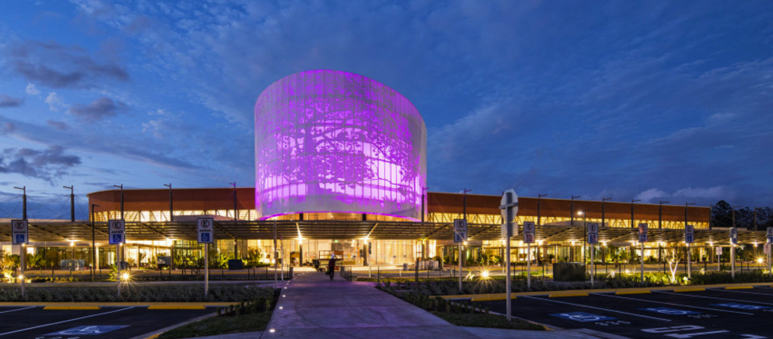
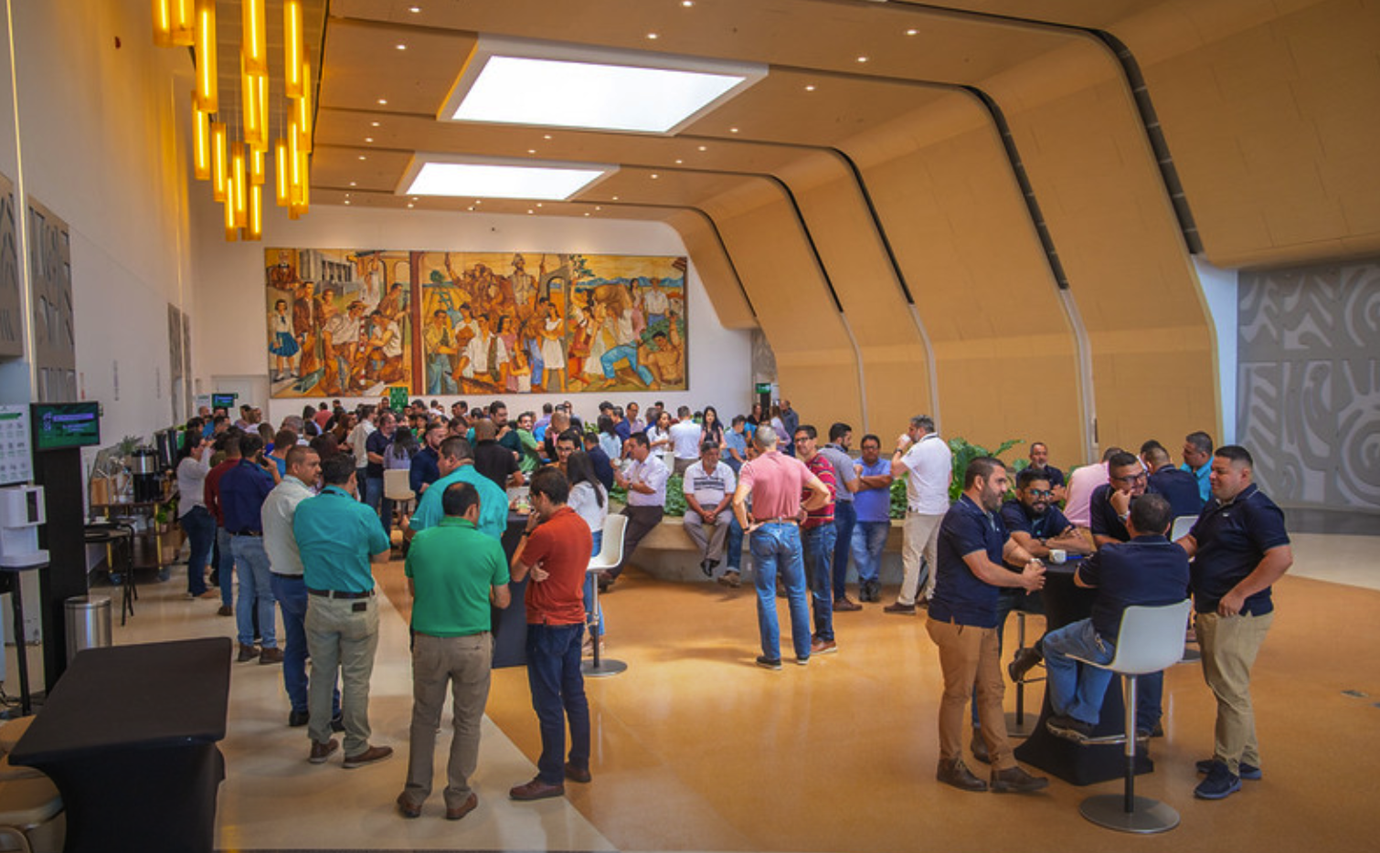
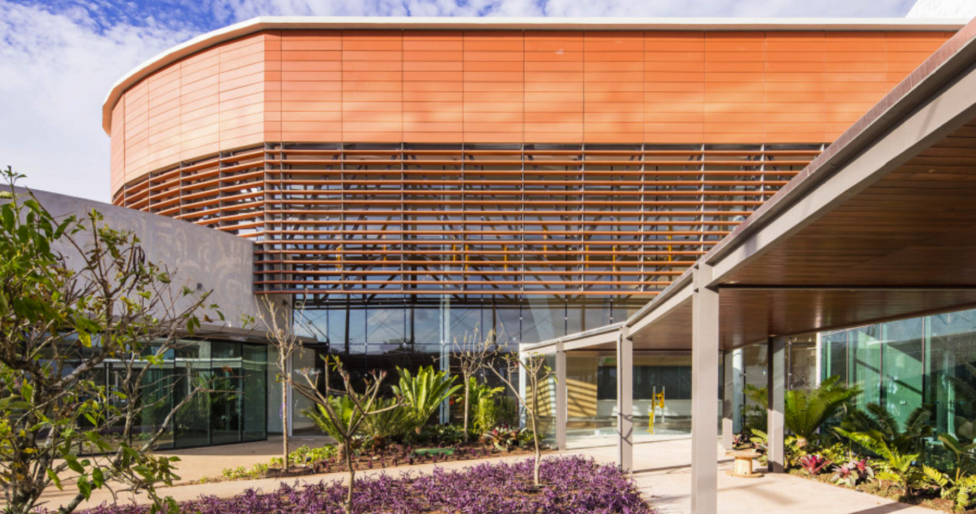
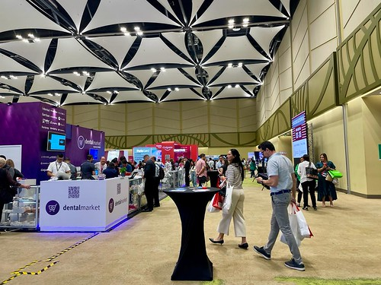
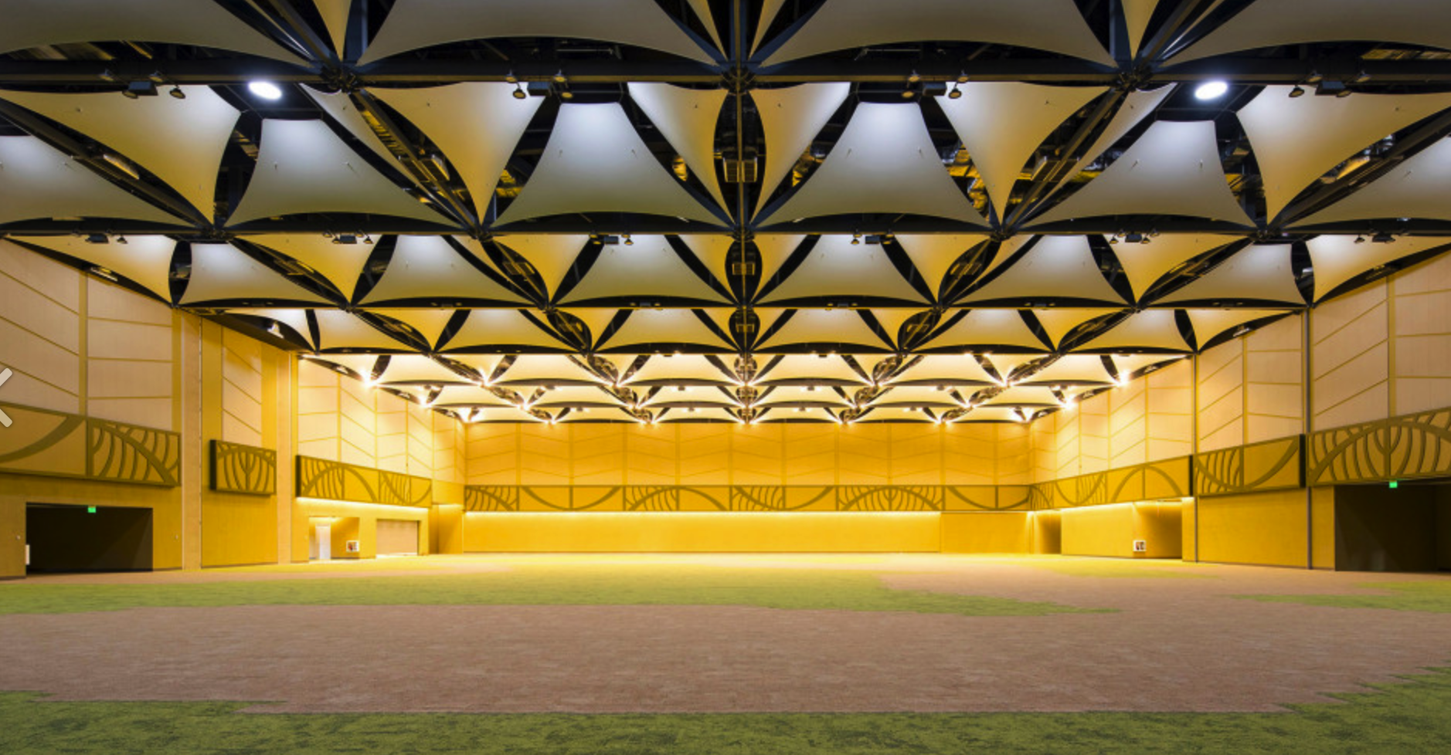
Costa Rica Convention Center
Virtual tour: https://costaricacc.com/360/desktop_esp/index.htm

Slide 5
Hotel

Slide 6
2024 Theme
‘Irradiation Technologies – Available, Sustainable and Growing’
Aligned with the UN goals for Sustainable Development, the irradiation industry provides valuable resources that contribute to the health and wellbeing of global industry and its citizens. Markets benefiting from irradiation include healthcare, industrial polymers, consumer products, cultural heritage, food, phytosanitary and environmental applications and materials. The role for irradiation continues to expand especially in areas such as healthcare, food provision, high tech materials and environmental applications.

Slide 7
2024 Program Concept
Getting the balance between business and science through multiple forum – Plenary, Tech Theatre and Posters
Presentations will take place in following formats:
Plenary – with emphasis on the business of radiation processing
Technical Theatres in the Exhibition hall – with emphasis on the ‘how’ and ‘what’ of radiation processing
Poster Presentations – with emphasis on the science of radiation processing.

Slide 8
2024 Plenary
Plenary Sessions – The business of radiation processing
Day 1: Focus on global business overview and updates
Day 2: Two strands (Sterilization and Phytosanitary)
Day 3: Regulatory update and Key-note speaker on Sustainability
Day 4: Education, leadership development and Poster Presentation; iia General Assembly

Slide 9
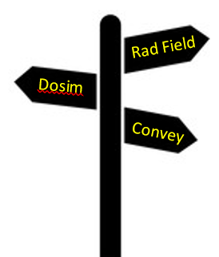
2024 Technical Theatres
Radiation Field | General stage to hear updates on innovation and developments in radiation processing
Dosimetry Square | Updates on dosimetry – innovation, equipment, regulatory
Conveyor Alley | Equipment and Manufacturing supports: Radiation equipment; product conveyance; robotics; manufacturing control systems.
Opportunity for exhibitors to showcase their innovations and product offerings. Creates a dynamic interactive space within the exhibition hall
Presentations will be short 15min slots. Approximately 40 topics to be showcased
Day 2-4 will begin at 9am in Exhibition Hall/TT for presentation and networking.

Slide 10
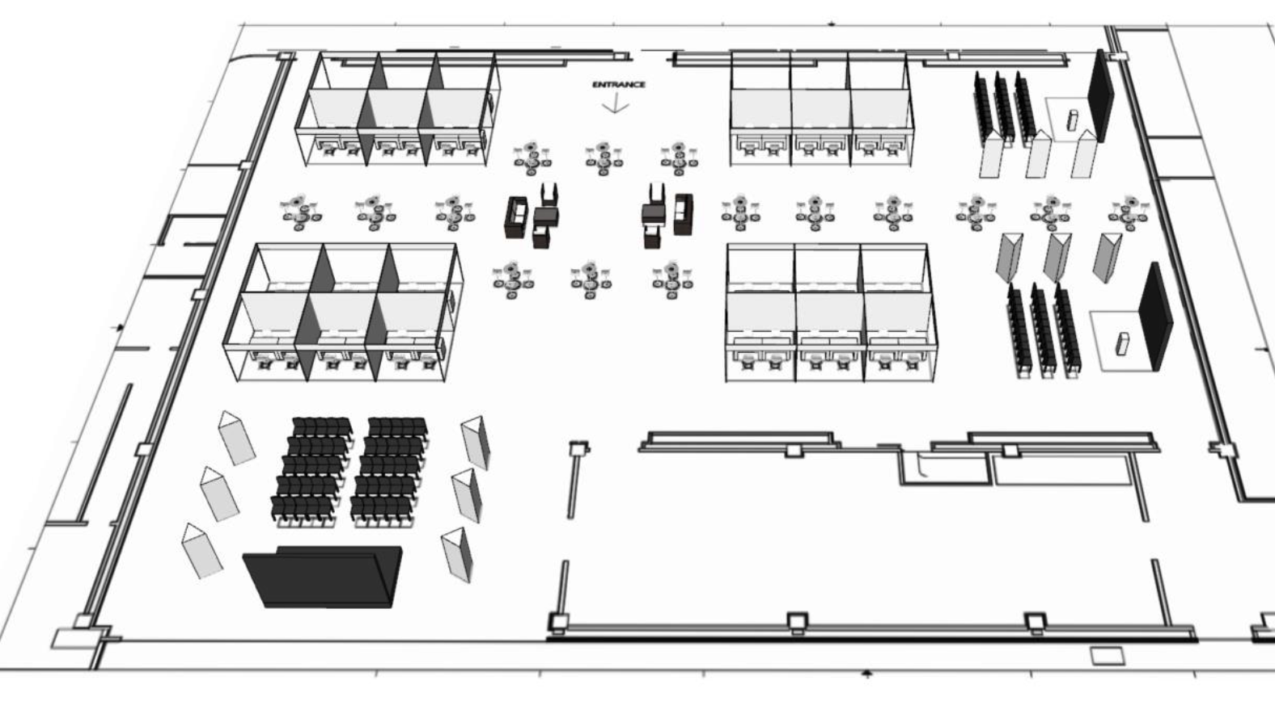
2024 Exhibition Floor Plan

Slide 11
2024 Posters
Poster Sessions – The science of radiation processing
Poster session on afternoon of Day 3
Hosted within exhibition space
May utilize the TechTheatre stages for short presentations
Judging committee to select best posters
Selected best posters may have opportunity to present to full plenary on Day 4

Slide 12
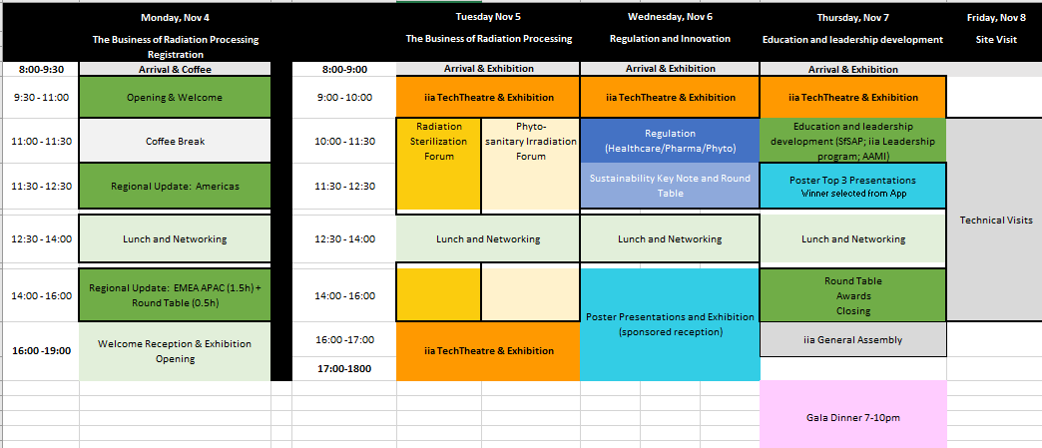
2024 Draft Program Structure

Slide 13
2024
Costa Rica
4-8 NOVEMBER 2024
Call for Abstracts

Slide 14
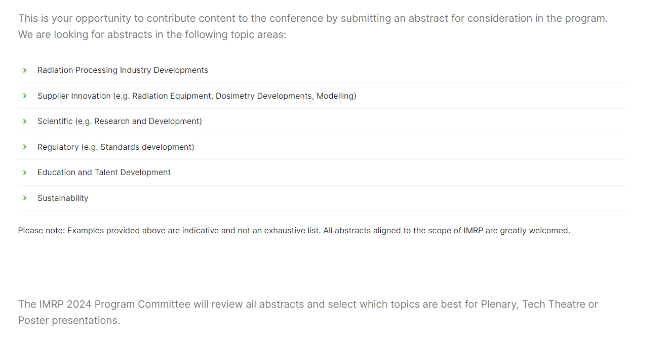
2024 Call for Abstracts
CfA is a call for all presentation material for all presentation forums (Plenary, TechTheatre or Poster)

Slide 15
2024 Call for Abstracts
Call for abstracts is early so submissions:
Don’t need to be perfect! A paragraph to summarize is sufficient for Program Committee to consider. For selected abstracts final details can be added after.
If selected, be able to present on the topic in Costa Rica in November 2024.
We are looking for business, technical and scientific content. We have various presentation opportunities.
If something scientific, it does not necessarily need to be complete. Ideal if it is, but perhaps the poster is an interim update of progress.
Share what you think is of interest to IMRP and radiation processing. If not sure…simply submit an abstract and let the Program Committee decide.
Use the CfA process to drive the content you want to hear about at IMRP 2024

Slide 16
2024 Publication Opportunities
Report of IMRP 2024 focused on the content from the Plenary Presentations
Recorded presentations (E-proceedings) from the Technical Theatres
Poster Presentation
Scientific Peer-Review publication.

Slide 17
2024 Benefits of abstract submission
Support of the IMRP 2024 Program
Share your expertise and knowledge with industry peers
Avail of opportunity to publish
Expand your industry profile
Expand your network and connections
Leave a forever legacy as an esteemed presenter at IMRP

Slide 18
2024 Program development roadmap
Phase 1 (Oct 23-March 24)
Promote the Call for Abstracts
Promote and encourage topics
Get as much submissions as possible
Phase 2 (Jan-May)
Review Abstracts
Align to draft program
Filter to Plenary, Poster or Tech Theatre
Refine the program
Phase 3 (May-Sept)
Support content generation
Refine the program
Finesse to perfect!

Slide 19
https://imrp-iia.com

